Slide 1
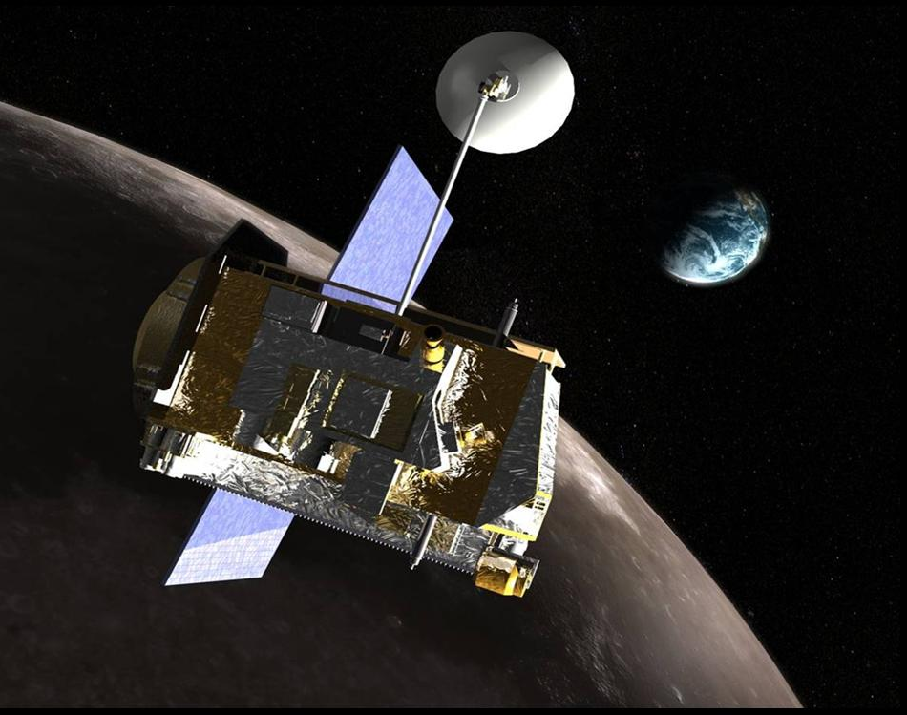




Water on the Moon: Remote Sensing from the Lunar Reconnaissance Orbiter
Michael Schaffner
Dr. William Boynton, LPL
Dr. Gerard Droege, LPL
19th Annual Arizona Space Grant Consortium Symposium
University of Arizona
April 21st, 2012

Slide 2
Water on the Moon: Remote Sensing from the Lunar Reconnaissance Orbiter
Michael Schaffner
Dr. William Boynton, LPL
Dr. Gerard Droege, LPL
19th Annual Arizona Space Grant Consortium Symposium
University of Arizona
April 21st, 2012

Slide 3
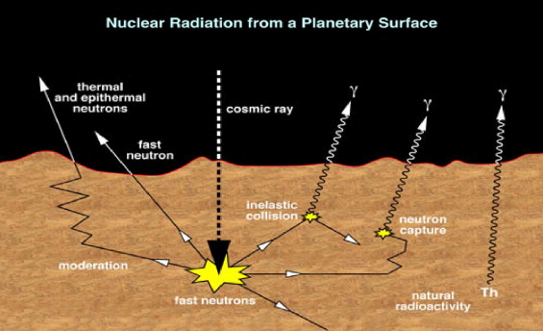
Intro to research
with the Lunar
Exploration Neutron
Detector (LEND)
Galactic cosmic rays (GCRs) regularly strike lunar atoms, and their energy knocks neutrons loose
Neutrons’ speeds are moderated best by similar-size hydrogen atoms
LEND detects these slower (epithermal) neutrons

Slide 4
Intro to research
with the Lunar
Exploration Neutron
Detector (LEND)
Galactic cosmic rays (GCRs) regularly strike lunar atoms, and their energy knocks neutrons loose
Neutrons’ speeds are moderated best by similar-size hydrogen atoms
LEND detects these slower (epithermal) neutrons

Slide 5
Intro to research
with the Lunar
Exploration Neutron
Detector (LEND)
Galactic cosmic rays (GCRs) regularly strike lunar atoms, and their energy knocks neutrons loose
Neutrons’ speeds are moderated best by similar-size hydrogen atoms
LEND detects these slower (epithermal) neutrons

Slide 6
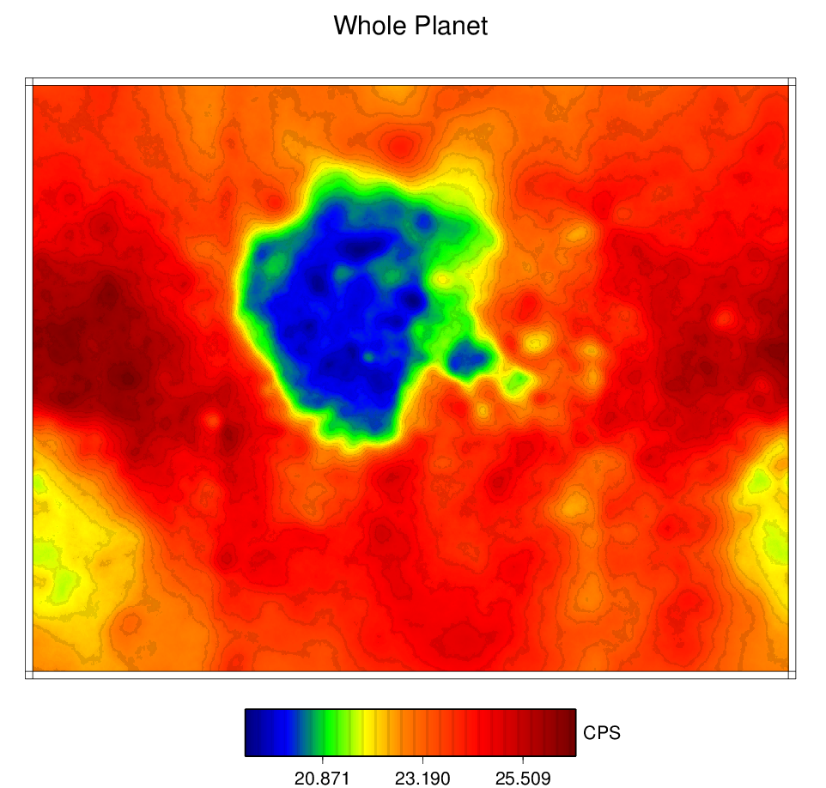
An introduction to
LEND research,
continued
The LEND instrument records the number of neutrons detected each second, along with latitude, longitude, altitude, angle, and more.
Using these data, scientists have mapped the surface of the moon to visually depict regions that deviate from the “normal” neutron counts.

Slide 7
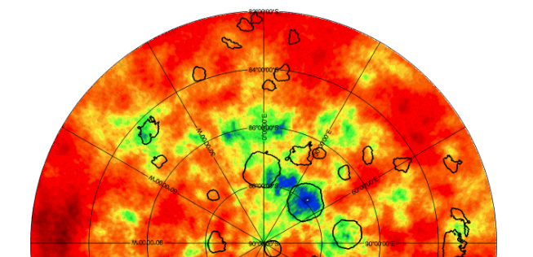
LEND Research Project
2011-2012
It had been previously theorized that lunar water would be found in the form of ice in Permanently Shadowed Regions (PSRs). LEND maps disagree:
South Pole
PSRs

Slide 8
LEND Research Project
2011-2012
Hypothesis: Variations in neutron flux are caused by thermal variations from the solar insolation and lack of lunar atmosphere.
Test: Average LEND data by time of lunar day to determine whether temperature variations affect the flux of thermal neutrons.

Slide 9
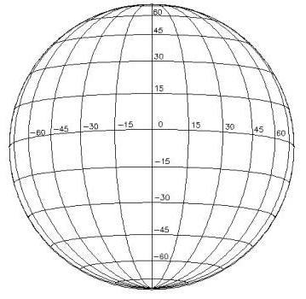
LEND Research Project
2011-2012
Original maps used only latitude and longitude, working with ~1,000 squares to capture data:

Slide 10
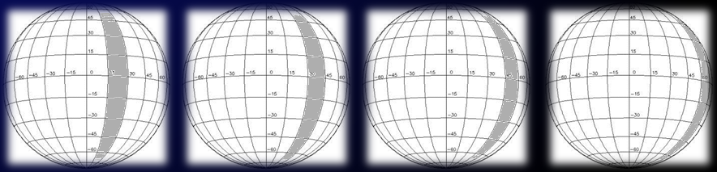
LEND Research Project
2011-2012
How to capture time of lunar day (28 Earth days) in addition to squares?
Bin each longitude region:
Days 1, 8, 15…
Days 2, 9, 16…
Days 3, 10, 17…
Days 4, 11, 18…

Slide 11
LEND Research Project
2011-2012
My colleague Jerry and I created:
9 latitude bands
24 longitude bands
Roughly 40 “time bins” per lat/lon square
With 3,000 to 6,000 data points
per lat/lon/time bin.

Slide 12
LEND Research Project
2011-2012
Q: Do we see the expected dependence on temperature of thermal neutrons detected?
To answer this, we plot thermal neutron counts for each lunar hour:

Slide 13
LEND Research Project
2011-2012
Q: Do we see the expected dependence on temperature of thermal neutrons detected?
A: Yes. And something else.

Slide 14
Conclusion
Temperature variations do play some part in thermal neutron flux from the lunar surface.

Slide 15
Conclusion
Temperature variations do play some part in thermal neutron flux from the lunar surface.
( And also:
Hydrogen’s behavior on the lunar surface is still not well understood.

Slide 16
Conclusion
Temperature variations do play some part in thermal neutron flux from the lunar surface.
( And also:
Hydrogen’s behavior on the lunar surface is still not well understood.
LEND data is very useful for detecting potential hydrogen deposits on the moon.

Slide 17
Conclusion
Temperature variations do play some part in thermal neutron flux from the lunar surface.
( And also:
Hydrogen’s behavior on the lunar surface is still not well understood.
LEND data is very useful for detecting potential hydrogen deposits on the moon.
The NASA Space Grant program is awesome. )

Slide 18
Acknowledgements
Special thanks to my advisor, Dr. Boynton, for his encouragement and mentorship; and to Dr. Jerry Droege, my daily mentor/co-coder.
I am also indebted to Susan Brew & Space Grant for an absolutely transformational experience this year!
Feedback: maschaff@email.arizona.edu

Slide 20
Backup

Slide 21
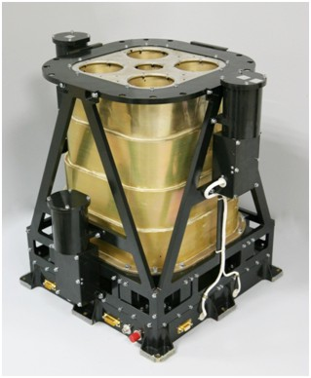
What is the
Lunar Exploration
Neutron Detector?
One of six instruments on NASA’s Lunar Reconnaissance Orbiter (LRO) spacecraft
Launched in 2009 with an est. cost of $600 million.
LEND was developed in cooperation with the Russian Space Research Insitute (IKI).

Slide 22
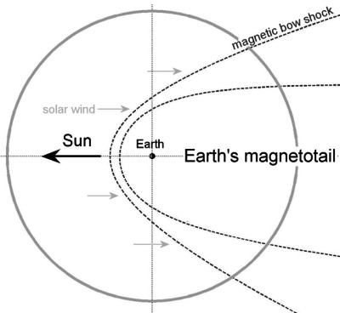
LEND Research Project
2011-2012
These bins make it relatively easy to study other significant questions, such as:
Q. Does the earth’s magnetosphere
shield the moon from GCRs?
  We can now compare data
  from full moon time bins
  with data in time bins
  outside the full moons.

Slide 23
LEND Research Project
2011-2012
Q: Does the earth’s magnetosphere
shield the moon from GCRs?
A: Our results, essentially “No”, are consistent with established
theories and of primary interest
to lunar and cosmic ray scientists.

